Slide 1
Paper Review
November 9, 2022
Vikas Kashyap, Tony Huang (Group 8)

Slide 2
1. Overview – Problem Statement and Objective
TABLE OF
CONTET
2. Highlights – Key Findings and Impacts
3. Critique – Strengths and Weaknesses
4. Q & A

Slide 3
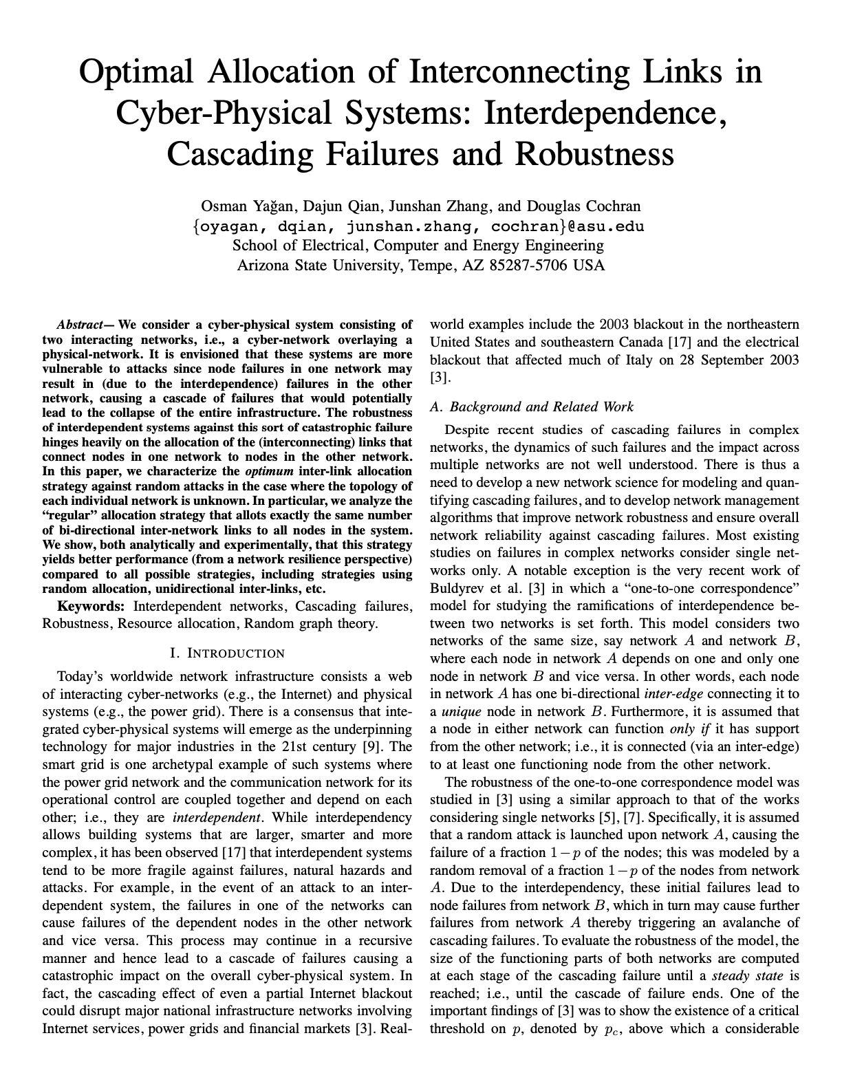
Overview of the Paper
Overview
Paper Title
Optimal Allocation of Interconnecting Links in Cyber-Physical Systems: Interdependence, Cascading Failures and Robustness
Author
Osman Yagan, Dajun Qian, Junshan Zhang, and Douglas Cochran
Publication &
Date
IEEE, (Volume: 23, Issue: 9, September 2012)
Key Topics
Interdependent networks, cascading failures, network robustness, resource allocation and random graph theory

Slide 4
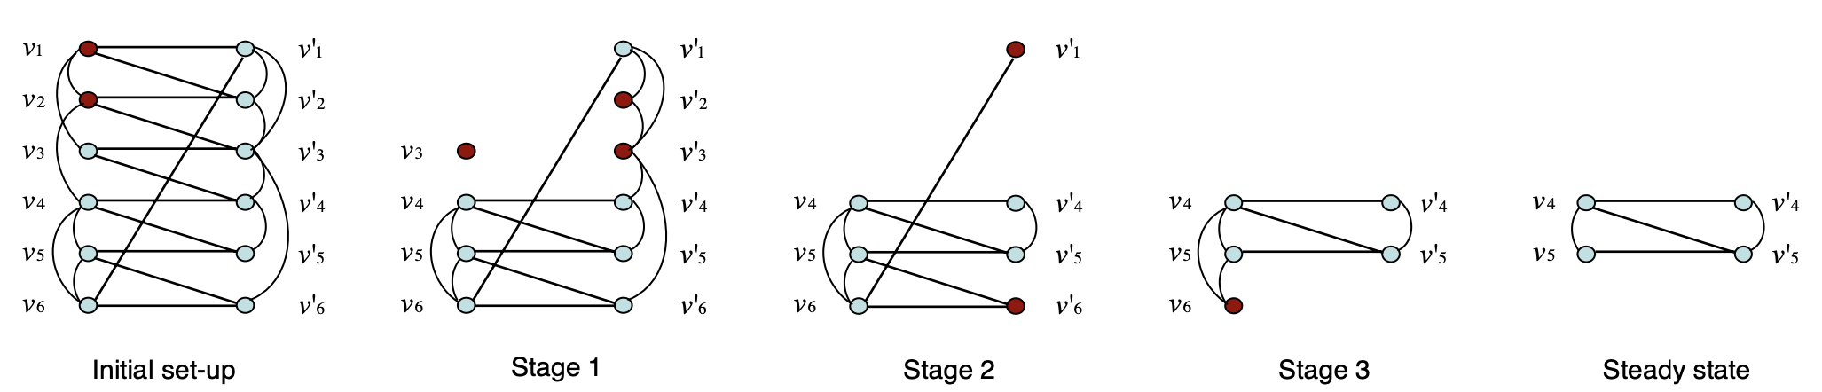
Background and Objective of the Paper
Overview
Background
Real-world networks are complicated and connected. Failures in one network have cascading effect on other networks.
Objective
The objective is to investigate optimal allocation and how edges should be connected between networks for maximum robustness.
Setting
Two interdependent networks are considered, and the effects of regular and random allocation are simulated.

Slide 5
Key and Results Findings
Key points and impact

Slide 6
Key and Results Findings
Key points and impact

Slide 7
Strengths of the Paper
Strengths and weaknesses

Slide 8
Weaknesses of the Paper
Strengths and weaknesses

Slide 9
References
APPENDIX
1. Optimal Allocation of Interconnecting Links in Cyber-Physical Systems: Interdependence, Cascading Failures and Robustness
https://ieeexplore.ieee.org/document/6148227

